Slide 1

END OF STUDIES PROJECT QuantLib 1.3
Presented by: | Ahmed Ayadi Nathan D.Kruck Nolan Potier | Supervised by: | Mme. Anne Marie HUGUES & Mr. Luigi BALLABIO

Slide 2
Plan
II-QuantLib Architecture
III-Library components
IV-Work flow
I-QuantLib Presentation

Slide 3
I-QuantLib 1.3
Quants and Developers
C++ , 2000
Ferdinando Ametrano and Luigi Ballabio
Open Source Initiative Certified
Boost library
Notes:
-The initial QuantLib release was 0.1.1 in Nov 2000
-Is primarily the work of Ferdinando Ametrano and Luigi Ballabio
-Boost has been a QuantLib requirement since July 2004

Slide 4
II-QuantLib Architecture
Instruments
Pricing Engine
Pattern allow to add new financial instrument
Notes:
Instruments allow to represent an financial instrument like a Vanilla Option with this differents parameters (volatility, strike, maturity …)
Pricing Engine allow to calculate the instrument values.

Slide 5
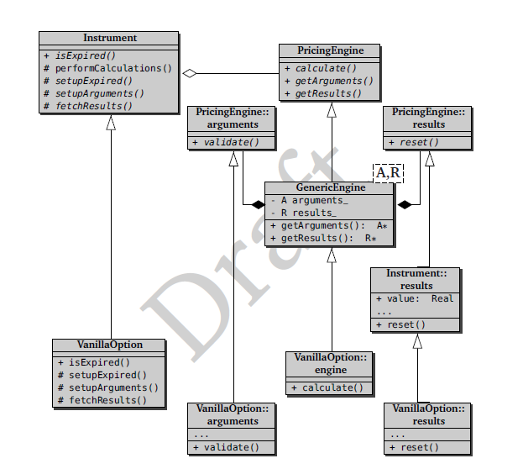

Slide 6
III-Library components

Slide 7
IV-Work flow

Slide 8
Thank You ☺
Questions

